Slide 1


Synthesis of Temporal Logic Testers for
CPSGrader
Auto-Grading A Cyber-Physical Systems Lab
Garvit Juniwal¹, Alex Donze¹, Jeff Jensen², Sanjit A. Seshia¹
¹UC Berkeley ²National Instruments
ESWEEK 2014
http://www.cpsgrader.org/

Slide 2
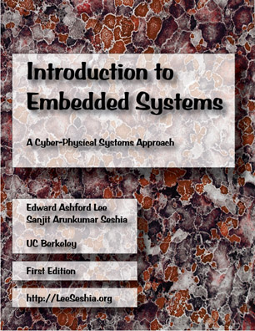
EECS 149: Intro to Embedded Systems UC Berkeley
This course introduces the modeling, design and analysis of computational systems that interact with physical processes.
Computer Science:
Abstract Away
the Physical World
Control Theory:
Deals Directly with Physical Quantities
Cyber Physical Systems:
Computational + Physical
http://leeseshia.org/
Notes:
The context of this work is the intro course on embedded …

Slide 3
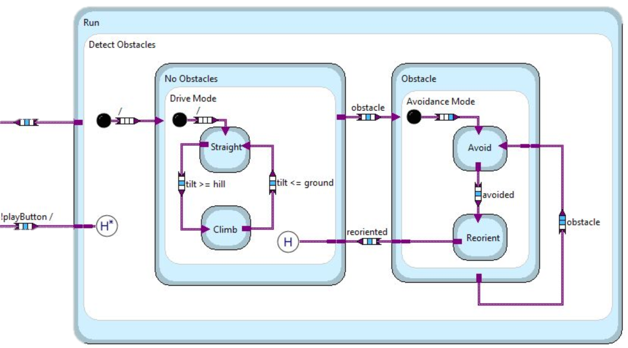
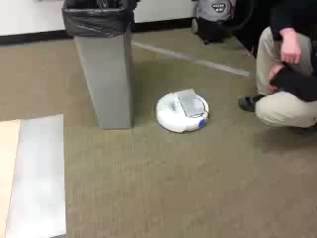
On-Campus Lab Assignment: The “Hill-Climbing” Robot

Slide 4



Virtual CPS
Advent of Massively Open Online Courses (MOOCs)
Specialized hardware
Grading is done via actual demonstration in lab conditions
Goal: Online Virtual Lab with learning experience “comparable” to On-Campus Real Lab
Notes:
MOOCs have become really popular and influential recently. Provide world class education to anyone with an internet connection.
To put a lab-based course online, in addition to the sheer pressure of scale, there are bigger challenges.

Slide 5
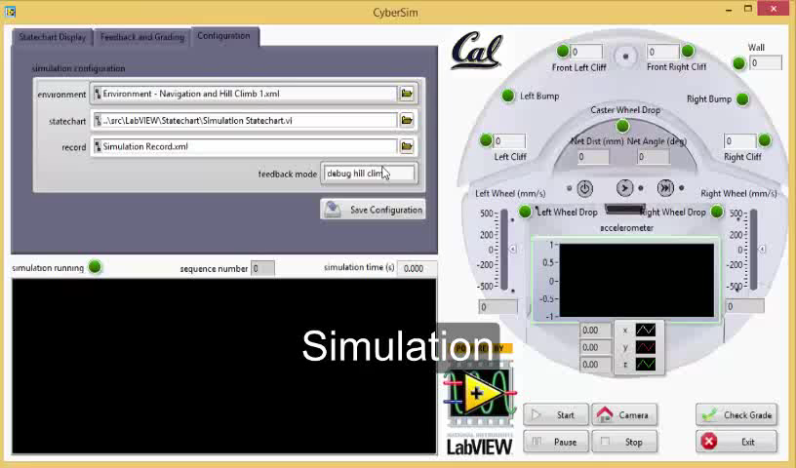
CyberSim + CPSGrader: Online Virtual Lab

Slide 6
CPSGrader: Contributions
Formalization of auto-grading problem in virtual labs via a notion of temporal logic testers
Efficient algorithms for automated synthesis of these testers
Empirical evaluation of the grader to demonstrate accuracy and efficiency on a database of actual student solutions
Notes:
The focus of my talk will be the technology underlying CPSGrader
we also formulate a notion of minimality where we can run a small number of tests to cover a much large space of tests

Slide 7
CPSGrader: Talk Outline
Background and auto-grader design
Notion of a test bench
Motivation for automated synthesis of test benches
Formal problem definition
Algorithm and theoretical results
Evaluation
Notes:
background and auto-grader design

Slide 8
STL Primer
Linear Temporal Logic (LTL)
Finally (F φ) – φ holds for at least one time point in future
Globally (G φ) – φ holds for all time points in future
Until (φ₁ U φ₂) – φ₂ holds for at least one time point t in future and φ₁ holds for all time points until t
Signal Temporal Logic (STL)
Extension of LTL to deal with continuous signals over continuous time
Allows for timing intervals
F_{[3, 4]} (x > 5) holds at t ⇔ x > 5 holds somewhere in [t+3, t+4]
G_{[3, 4]} (x > 5) holds at t ⇔ x > 5 holds everywhere in [t+3, t+4]
(y < -1) U_{[3, 4]} (x > 5) holds at t ⇔ x > 5 holds at some t’ in [t+3, t+4] and y < -1 holds everywhere in [t, t’]
Parametric STL
F_{[0, τ]} (x > π)
Notes:
Language to talk about temporal behavior of systems
Evaluated on a point-wise timed trace

Slide 9
Auto-Grading and Feedback Generation
Auto-grading = verification + debugging
Employ Simulation-based (run-time) verification
get simulation trace
monitor signal temporal logic properties
localize faulty behavior
Notes:
auto-grading: Given a solution to a CPS lab assignment, need to check whether it meets desired objectives or presents faulty behavior.
we employ a simulation based run-time verif approach, where we take a candidate solution, get a simulation trace using a black box simulator, monitor STL properties on trace to localize faulty behavior
we prefer a simulation based approach instead of a purely static one because the model of the environment in which the controller is executing is “complex” -> highly non-linear, treat simulator as black box
I would like to make a minor note that we treat goals/objectives in the same fashion as faults by thinking of failure to meet a goal as a fault. So we only talk about fault detection.

Slide 10

Fault Detection via Test
Test: Environment + Monitor
Environment: Arena composed of obstacles and hills, dynamic input stimuli, initial conditions
Monitor: STL formula that captures presence of fault in a trace
A test is triggered by a controller if the fault property holds on the simulation trace in the environment.
+
0.5
0.5
Notes:
We first define the notion of a test which a basic building block in fault detection. Would like to stress on this definition since it might different from usual definition of tests that we are familiar with.
A test consists of two parts: an environment, a monitor
The environment is completely deterministic, includes initial conditions as well as dynamic stimuli
an example of failure to meet goal == fault
0.4!=0.5 because falling from cliff isn’t allowed
- STL summary slide

Slide 11
Are we done?
Grading should be robust to variations in environment and student solutions
Time of climb depends on wheel speeds, strategy, initial heading direction
Height of climb depends on ramp height and robot dimensions
Introduce parameters in environment and STL formula of a test to create a parameterized test
Solve a parameter synthesis problem to determine good values of parameters
Notes:
param synth: which we will see in more detail next

Slide 12
Parameterization
Parameterized Test: collection of tests over a parameter space
Fault Subspace: subset of parameter space that corresponds to tests that are indicative of the fault
label a candidate solution as faulty ⇔ at least one test in the fault subspace is triggered
Test Bench
+
+
Notes:
Let’s talk about some definitions and examples related to parameterization.
A parameterized test is a test with parameters. we can think of it as a collection of tests over a parameter space
Consider the hill climbing test from before.
We saw before how student solutions vary widely in terms of how long it takes to get to the top (mostly due to varying initial orientation and choice of wheel speed) and also that the top is dependent on the height of the ramp.
So we create a parameterized test by introducing
- a parameter theta in the environment which encodes the initial orientation of robot
- a timing parameter tau to capture the maximum allowed time
- a value parameter h to capture height of the ramp
where theta can be between -180 to 180 and tau and h can be any positive real numbers (which is the parameter space)
but not all tests in this collection are indicative of the fault
click
hence we define a fault subspace…
a simple example of a fault subspace is …, note that in this example it appears that the general definition might be an overkill since only one test seems to be critical
but we will soon see a more convincing and slightly involved example
we call the combination of a parameterized test and a fault subspace as a TEST BENCH

Slide 13
Synthesis of Test Benches: Challenges
Challenge 1: Finding the fault subspace manually is tedious.
have to try several variations and inspect traces carefully
Solution: Coming up with labeled reference controllers is relatively easy → synthesize from examples!
Challenge 2: Fault subspace can be very large
Solution: Minimal Adequate Test Sample
Notes:
coming up with test bench constraints that accurately capture the fault is tedious
We would have to manually try several variations and carefully inspect the traces
reference solutions; ones that are known to have a fault and ones that do not have the fault. Implement a few manually. Grade a few actual student solutions manually.

Slide 14
Synthesize Fault Subspace from Labeled Reference Controllers
Problem: Given
a parameterized test Γ over a parameter space 𝔘,
two sets of reference controllers:
𝒞⁺(with fault), 𝒞⎯ (without fault)
Find a fault subspace ρ ⊆ 𝔘, such that the test bench (Γ, ρ) correctly labels all controllers in 𝒞⁺ and 𝒞⎯
Notes:
coming up with test bench constraints that accurately capture the fault is tedious
Think about the hill climbing test. Since time of climb is sensitive to wheel speed, solution strategy,
height of climb depend of the height of the ramp, dimensions of the robot etc.
We would have to manually try several variations and carefully inspect the traces
reference solutions; ones that are known to have a fault and ones that do not have the fault. Implement a few manually. Grade a few actual student solutions manually.
split

Slide 15
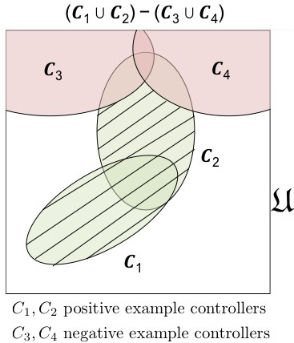
Problem: Given (1) a parameterized test Γ over a parameter space 𝔘, (2) two sets of reference controllers: 𝒞⁺(with fault), 𝒞⎯ (without fault). Find a fault subspace ρ ⊆ 𝔘, such that the test bench (Γ, ρ) correctly labels all controllers in 𝒞⁺ and 𝒞⎯
Solution: Include every test which
is triggered on at least one reference controller with the fault, but
is NOT triggered on any reference controller without the fault.
Lenient grading:
Don’t include tests that aren’t triggered on any controller with or without the fault.
Benefit of doubt!
fault subspace
C₁, C₂ reference controllers WITH fault
C₃, C₄ reference controllers WITHOUT fault
Notes:
increase coverage; linient approach for not including tests which pass on neither pass on sols with fault nor on sols without fault

Slide 16
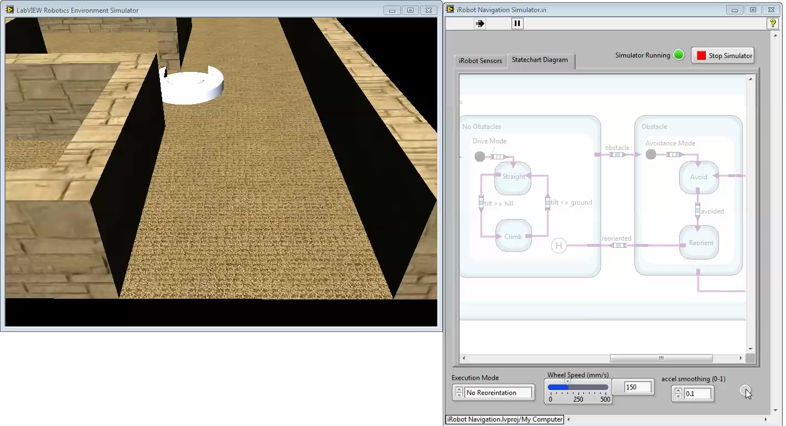
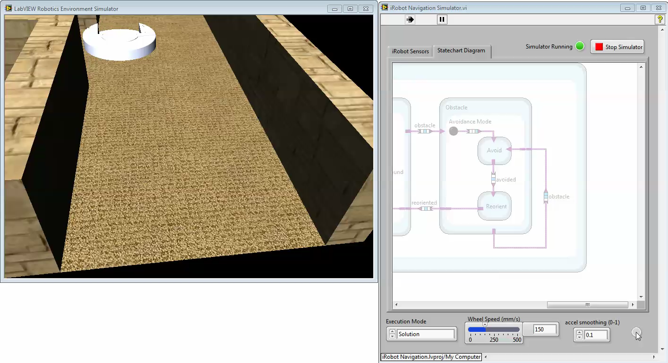
Reorientation Tolerance Fault (CIRCLE)
Check for: θ == θ_{init}
✖
Check for: abs(θ – θ_{init}) ≤ ε
✔
F(θ₀ & (close_δ U_{[0,τ]}(θ₁₈₀ & close_δ U_{[0,τ]}θ₀))
θ₀: abs(θ)<2
θ₁₈₀: abs(θ)>178
close_δ: abs(x – x_{ref})<δ
Notes:
a student solution has a guard which checks equality of a signal with certain desired value.
Since the system is polling based, If this guard checks for strict equality highly unlikely to become true
In this case, the robot is in a state where it is turning to find a desired angle and it just keeps turning because the guard is too strong
τ – maximum allowed period of turning
δ – maximum allowed margin of movement while turning
Define the problem formally

Slide 17
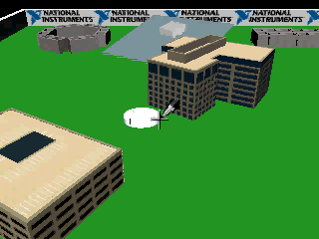
F(θ₀ & (close_δ U_{[0,τ]}(θ₁₈₀ & close_δ U_{[0,τ]}θ₀))
4
τ
Controller with fault
0.05
δ
Notes:
the square represents parameter space of tau and h with reasonable upper and lower limits
the hatched region is the tb constraint
let us imagine that the bot takes 4 sec to complete half rotation and stays within a delta margin of 0.05

Slide 18
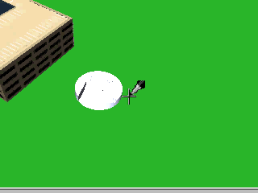
F(θ₀ & (close_δ U_{[0,τ]}(θ₁₈₀ & close_δ U_{[0,τ]}θ₀))
4
τ
8
Controller with fault
0.05
Controller without fault
δ
0.1
Notes:
summary of algorithm (discretization etc.)

Slide 19
Computing Fault Subspace
Discretize each parameter at some granularity with upper and lower bounds. For k parameters and maximum dimension of size N → O(N^{k}) sample points
Brute Force: For each labeled controller, check all O(N^{k}) sample parameter points to compute the region where the fault is triggered.
p₁
p₂
Triggered
Not Triggered

Slide 20
Monotonicity
For some order ⋖, a parameterized test Γ is monotonic in a parameter p if and only if for any controller
∀p₁ ⋖ p₂ . Γ(p₁) is triggered ⇒ Γ(p₂) is triggered
F(θ₀ & (close_δ U_{[0,τ]}(θ₁₈₀ & close_δ U_{[0,τ]}θ₀))
close_δ: abs(x – x_{ref})<δ
Is monotonic in δ and 𝜏

Slide 21
Use of Monotonicity
For k monotonic parameters, efficient fault subspace computation:
k = 1 : O(log N) k = 2 : O(N) k ≥ 3 : O(N^{k-1})
This is also the best we can do (without additional assumptions)
p₁
Triggered
Not Triggered
p₂
Illustration for k = 2

Slide 22
Use of Monotonicity
Grading a fault = searching for a triggered test within fault subspace
Minimal Adequate Test Sample α: minimal number of tests such that checking within the fault subspace ≣ checking within α
4
τ
8
τ
δ
0.05
δ
Monotonicity
0.1

Slide 23
Auto-Grading Flow
incline/obstacle placements,
initial position/orientation
Controller
NI Robotics Simulator
Simulator
Environment
Timed sequence of values like wheel speeds, position, orientation, etc.
Fault
Monitor
Trace
Minimal Adequate Test Sample
Monitoring Engine
Breach
Signal Temporal Logic
timing intervals, thresholds
Faults, Feedback
Notes:
start with a controller
pick a test from the constrained subset of tests, which is shown in green
it contains an env and monitor..
if at least one green test passes, label as faulty
move it right before end of talk as a summary picture
remove red dots

Slide 24
Evaluation
Evaluated using ~2000 student solutions from an on-campus offering of the EECS 149.
Devised a library of faults and their respective parameterized environments and STL formulae.
3 goal properties and 5 specific kinds of faults
Manually labeled all solutions for each fault in the library as a positive or negative example.
Two important evaluation criteria: Accuracy and Efficiency
Notes:
The auto-grader didn’t falsely label any correct solution as faulty, neither did it miss any faults.
----- Meeting Notes (3/7/14 14:11) -----
objective is to get accuracy
against manual approach
no false labels
no misses

Slide 25
Evaluation: Accuracy
For each fault – 100 examples as the “training set” and rest as “test set” for the synthesized test bench.
Test Bench | N+ | N++ | N- | N--
avoid_front | 74 | 74 | 27 | 27
avoid_left | 78 | 78 | 23 | 23
avoid_right | 82 | 82 | 19 | 19
circle | 2 | 2 | 99 | 99
hill_climb_1 | 49 | 36 | 345 | 345
hill_climb_2 | 35 | 32 | 359 | 359
what_hill | 220 | 216 | 174 | 156
filter | 8 | 7 | 354 | 339
N+ : number of manually graded solutions found to have fault
N++ : number of solutions (from N+) that the auto-grader labels as faulty
N- and N– are defined similarly
Notes:
The auto-grader didn’t falsely label any correct solution as faulty, neither did it miss any faults.
Training set, test set, precision, recall, f-score
----- Meeting Notes (3/7/14 14:11) -----
objective is to get accuracy
against manual approach
no false labels
no misses

Slide 26
Evaluation: Efficiency
Each call to the auto-grader runs 6 simulations (~ 7 sec each)
Every test bench is then evaluated on the simulation traces (< 1 sec each)
Total : < 50 sec per grade
Notes:
The auto-grader didn’t falsely label any correct solution as faulty, neither did it miss any faults.
Training set, test set, precision, recall, f-score
----- Meeting Notes (3/7/14 14:11) -----
objective is to get accuracy
against manual approach
no false labels
no misses

Slide 27
Future Directions
Partial and Extra Credit
Quantitative semantics of Signal Temporal Logic
Online/Incremental Algos for Run-Time Verification
Machine Learning for New “Unknown” Faults
Wider Applicability:
No assumptions about the form of controller, environment or simulation model.
Other labs -- e.g., analog and mixed signal circuits (possibly using Time Frequency Logic instead of STL)
Debugging problems for embedded controllers with a plausible fault model

Slide 28
Key Statistics from EECS149.1x
86% found auto-grader feedback useful for debugging
>90% of solutions that passed CPSGrader worked on the real robot with no or minor modifications [optional hardware track]
Majority of students spent 5-10 hours/week
4% of peak enrollment passed the course (342 of 8767)
Longer talk at WESE on Thu, Oct. 16
http://www.cpsgrader.org/
28
Notes:
number of students
future work from paper
statistics on thank you slide

Slide 29
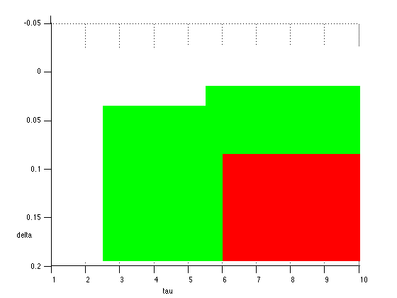
Reorientation Tolerance Fault
Notes:
remove

Slide 30
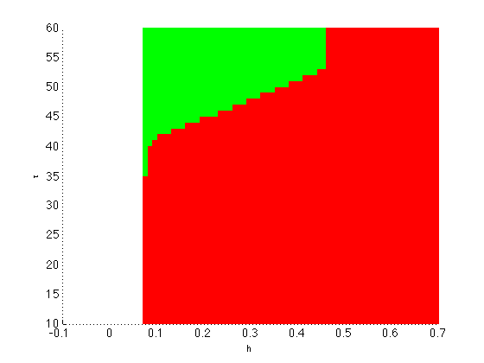
For hill climb

